Slide 1
Week 6
Neural Networks

Slide 2
Overview & Plan
Theory intensive lesson this week and Practical intensive lesson next week
The aim of Neural Networks
A look at the human brain
The perceptron
Perceptron calculations
A perceptron in a network
Forward Propagation (activation functions, making predictions)
Optimization via Backpropagation
Benefits of Neural Networks (Deep Learning)
Problems with Neural Networks (Overfitting)
Addressing overfitting via Regularization
Applications of Neural Networks

Slide 3
The aim of Neural Networks
Predict output based on input
Takes in a set of features, and makes a prediction
Either classification (discrete) or regression (continuous)
Just like any other algorithm (logistic regression, decision tree, SVM, etc.)
The concept of Neural Networks has, however, extended to taking non-numerical inputs, such as:
Images
Text
Audio

Slide 4
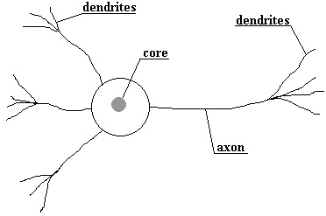
The Human Brain
Diagram shows a single neuron in brain
Dendrites models the input
Core/Nucleus models the computation
Axiom models the output
The axiom connects to other dendrites, creating a chain
Each wire connecting the dendrite to the core has a ‘weight’ associated with it, which models the weight
Communication is done via pulses of electricity

Slide 5
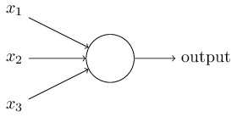
The Perceptron
Aims to emulate the human neuron
x₁ models an input dendrite
Node models the nucleus
Lines model the weights
Output models the axiom

Slide 6
Neuron vs Perceptron

Slide 7
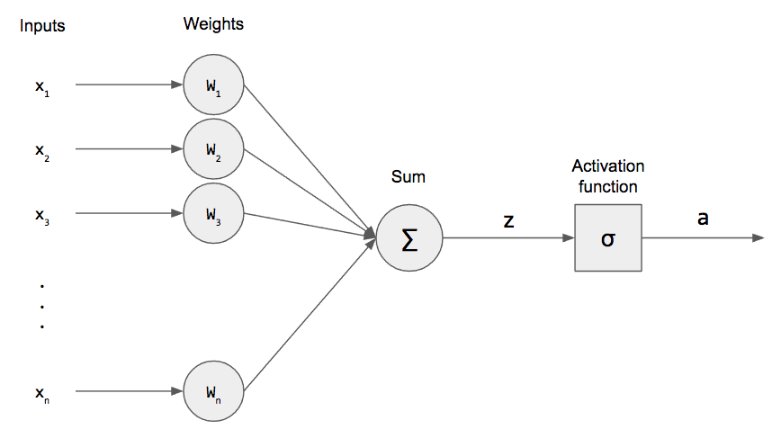
Perceptron Calculations (I)

Slide 8
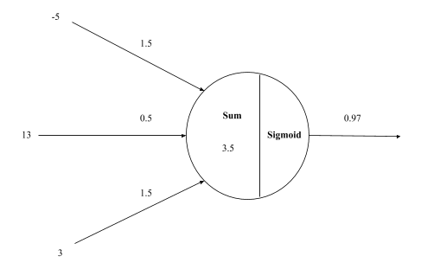
Perceptron Calculations (II)

Slide 9
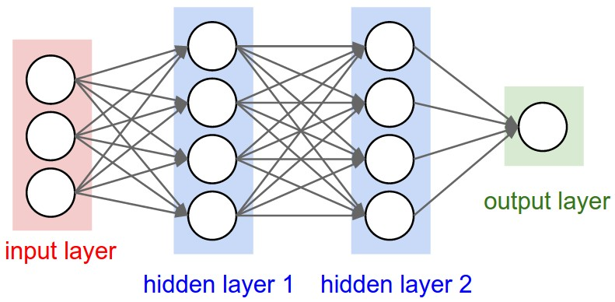
A perceptron in a network

Slide 10
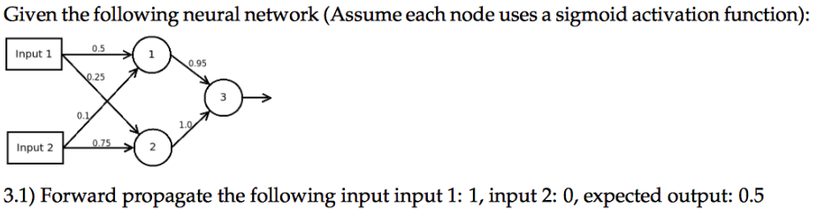
Forward Propagation
Used to make our predictions
Keep calculating as you go down the chain of nodes
Solve the following example to find the output at Node 3:

Slide 11
Optimization via Backpropagation
When we first create a Neural Network, we assign random values to weights
After the first round of forward propagation, we have our prediction
However, our first predictions are likely to be extremely inaccurate - thus, we must improve our weights to make them better suited to the inputs
Compare this prediction to the training instance real output via a cost function, which takes the sum of the errors
‘Propagate’ the error backwards (requires Linear Algebra knowledge)
Essentially, we calculate how much each weight contributed to the overall error
Based on that proportion, we update the weight
Eg. if one weight contributed a large error, it is given a large update to its value

Slide 12
Benefits of Neural Networks
Due to large number of weights (in comparison to Logistic Regression), they are very accurate
The utilization of numerous layers allows them to learn embedded relationships, such as those between features (in comparison to Logistic Regression)
Can be expanded to include data in the form of images, audio, text, etc

Slide 13
Problems with Neural Networks
Computationally expensive to run
Steep learning curve
Prone to overfitting
Overfitting: the production of a model that corresponds too closely or exactly to a particular set of data, and may therefore fail to fit additional data or predict future observations reliably
Large number of weights results in ability to predict training set almost perfectly
However, this doesn’t generalize in the real world

Slide 14
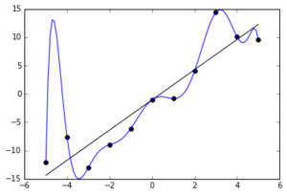
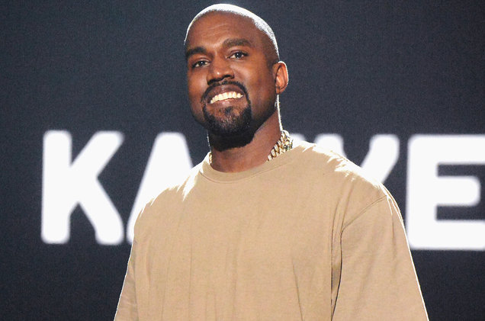
Overfitting Example
Scenario: Neural Network to detect whether Kanye West is part of an image
This image is part of the training set
Overfitting occurs if the Network always searches for the ‘K’ and ‘E’ behind Kanye
However, this doesn’t model real world instances well

Slide 15
Addressing Overfitting with Regularization: Data Augmentation
Often, it can be overcome by providing more training data, as this provides more instances of the ‘general idea’
Eg. if I were to provide more images of Kanye West’s face, the network would learn that this is far more common/regular
Distort instances to multiply the amount of training data (flip, stretch, crop, etc)
For example:

Slide 16
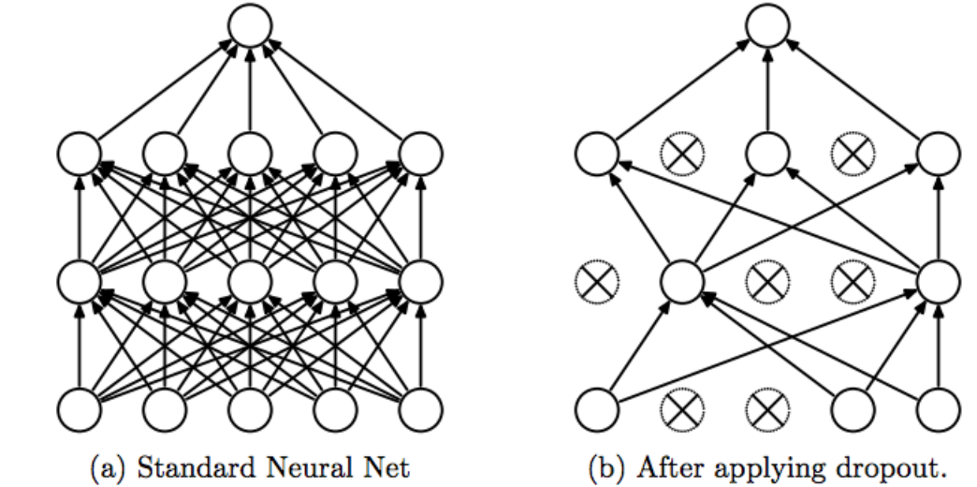
Addressing Overfitting with Regularization: Dropout
Set a probability value for each layer
Input layer: 0.1-0.2
Hidden layers: 0.4-0.5
Output layer: 0
Each node in that layer has the given probability of deactivating in each forward propagation round
Node returns 0 if deactivated
Creates an element of randomness
Recent (2017) development
Provides 5-6% improvement

Slide 17
Applications of Neural Networks
Regular Machine Learning problems, eg:
Breast cancer detection based on health indicators
Predicting whether a customer will buy a product based on their demographic
Estimating the price of a house based on its basic information
Advanced Machine Learning problems, eg:
Modelling the pose of a human playing a sport based on an image of the human
Having natural language conversations with humans
Photoshopping a face of one person onto the body of another
Predicting whether a post on Twitter is considered hateful or not
Detecting whether a human face is present in a photo
Predicting whether the sound waves of a human heart indicate that the human has a heart disease
For the advanced problems, more complex variations of Neural Networks are required. We will look into these.

